Slide 1
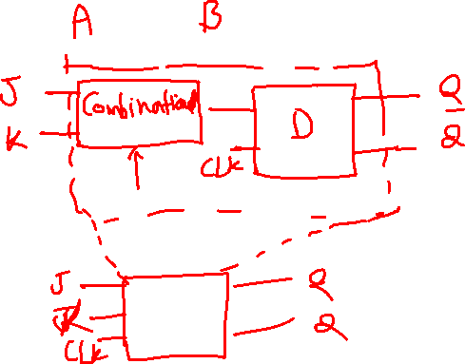
Flip Flop Conversion

Slide 2
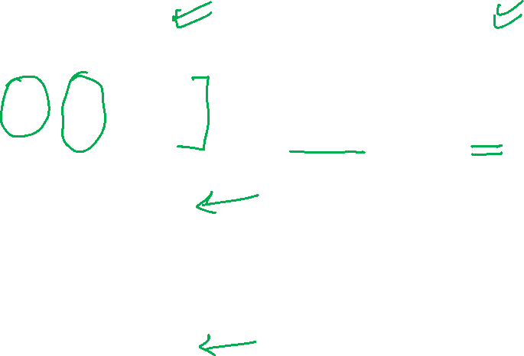
SR Flip Flop
Truth Table Characteristic Table Excitation table
Clk | S | R | Q(t+1)
0 | x | x | Qt
1 | 0 | 0 | Qt
1 | 0 | 1 | 0
1 | 1 | 0 | 1
1 | 1 | 1 | Not allow
Qt | S | R | Q(t+1)
0 | 0 | 0 | 0
0 | 0 | 1 | 0
0 | 1 | 0 | 1
0 | 1 | 1 | X
1 | 0 | 0 | 1
1 | 0 | 1 | 0
1 | 1 | 0 | 1
1 | 1 | 1 | X
Qt | Q(t+1) | S | R
0 | 0 | 0 | X
0 | 1 | 1 | 0
1 | 0 | 0 | 1
1 | 1 | X | 0

Slide 3
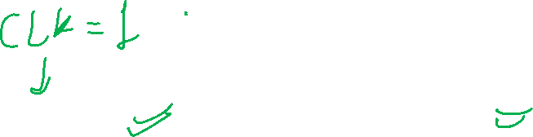
D Flip Flop
Truth Table Characteristic Table Excitation table
Clk | D | Q(t+1)
0 | x | Qt
1 | 0 | 0
1 | 1 | 1
Qt | D | Q(t+1)
0 | 0 | 0
0 | 1 | 1
1 | 0 | 0
1 | 1 | 1
Qt | Q(t+1) | D
0 | 0 | 0
0 | 1 | 1
1 | 0 | 0
1 | 1 | 1

Slide 4
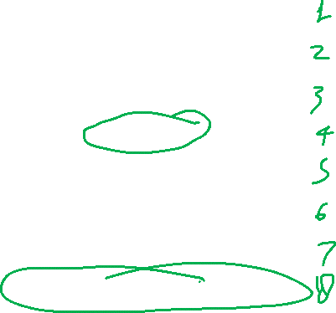
JK Flip Flop
Truth Table Characteristic Table Excitation table
Qt | J | K | Q(t+1)
0 | 0 | 0 | 0
0 | 0 | 1 | 0
0 | 1 | 0 | 1
0 | 1 | 1 | 1
1 | 0 | 0 | 1
1 | 0 | 1 | 0
1 | 1 | 0 | 1
1 | 1 | 1 | 0
Qt | Q(t+1) | J | K
0 | 0 | 0 | X
0 | 1 | 1 | X
1 | 0 | X | 1
1 | 1 | X | 0
Clk | J | K | Q(t+1)
0 | x | x | Qt
1 | 0 | 0 | Qt
1 | 0 | 1 | 0
1 | 1 | 0 | 1
1 | 1 | 1 | Qt’

Slide 5

T Flip Flop
Truth Table Characteristic Table Excitation table
Clk | T | Q(t+1)
0 | x | Qt
1 | 0 | Qt
1 | 1 | Qt’
T | Qt | Q(t+1)
0 | 0 | 0
0 | 1 | 1
1 | 0 | 1
1 | 1 | 0
Qt | Q(t+1) | T
0 | 0 | 0
0 | 1 | 1
1 | 0 | 1
1 | 1 | 0

Slide 6

Step to convert Flip Flop
Identify available and required FF.
Make Excitation Table of available FF.
Make characteristic table of required FF.
Make entry of available FF input on characteristic table.
Write Boolean expression for available FF
Draw the circuit diagram.

Slide 7
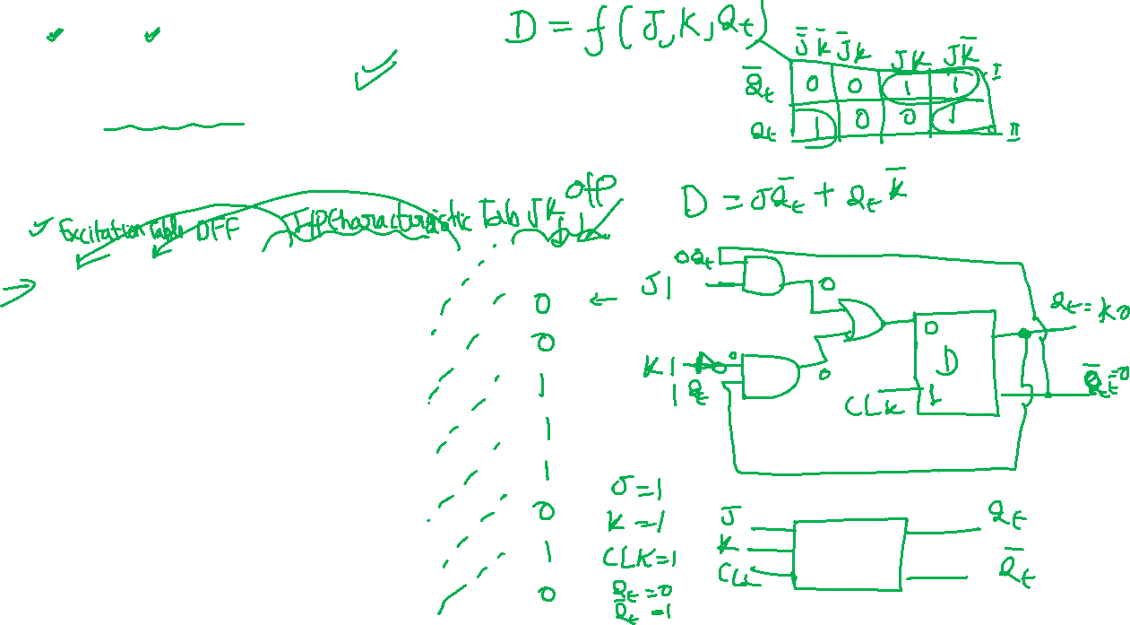
D to JK flip flop
Identify available and required FF.
Make Excitation Table of available FF.
Make characteristic table of required FF.
Make entry of available FF input on characteristic table.
Write Boolean expression for available FF
Draw the circuit diagram.
Qt | Q(t+1) | D
0 | 0 | 0
0 | 1 | 1
1 | 0 | 0
1 | 1 | 1
Qt | J | K | Q(t+1) | D
0 | 0 | 0 | 0
0 | 0 | 1 | 0
0 | 1 | 0 | 1
0 | 1 | 1 | 1
1 | 0 | 0 | 1
1 | 0 | 1 | 0
1 | 1 | 0 | 1
1 | 1 | 1 | 0

Slide 8
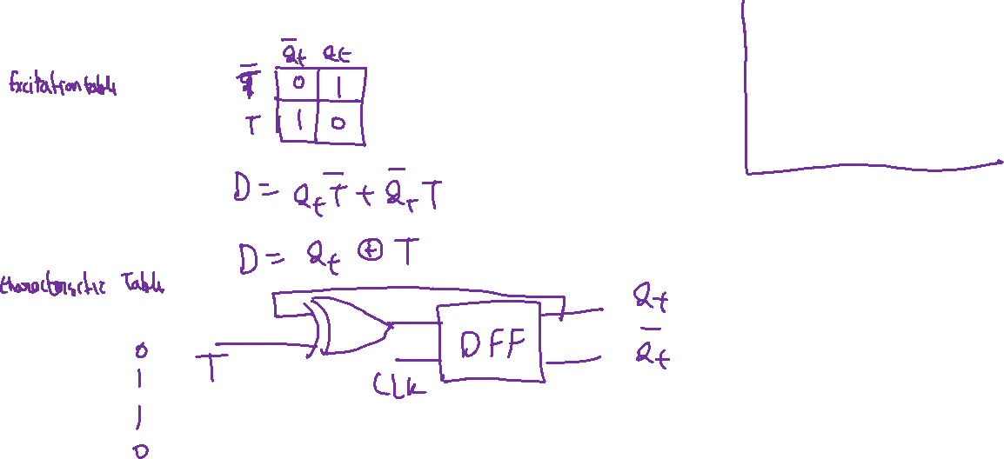
D to T flip flop
Identify available and required FF.
Make Excitation Table of available FF.
Make characteristic table of required FF.
Make entry of available FF input on characteristic table.
Write Boolean expression for available FF
Draw the circuit diagram.
Qt | Q(t+1) | D
0 | 0 | 0
0 | 1 | 1
1 | 0 | 0
1 | 1 | 1
T | Qt | Q(t+1) | D
0 | 0 | 0
0 | 1 | 1
1 | 0 | 1
1 | 1 | 0

Slide 9
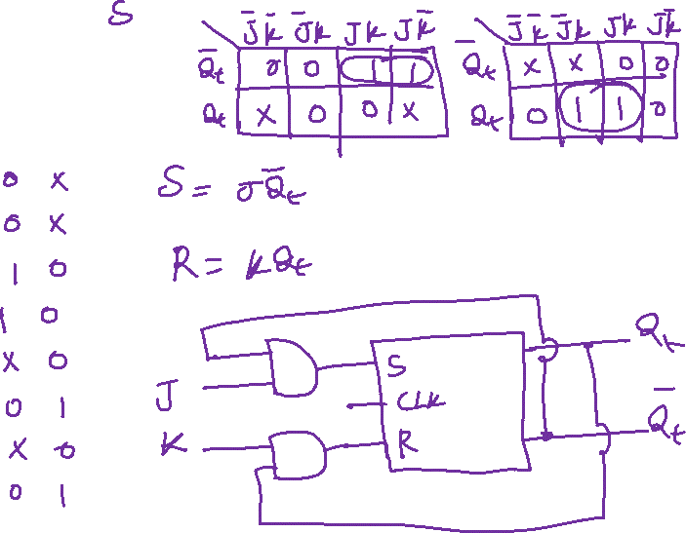
SR to JK flip flop
Qt | Q(t+1) | S | R
0 | 0 | 0 | X
0 | 1 | 1 | 0
1 | 0 | 0 | 1
1 | 1 | X | 0
Qt | J | K | Q(t+1) | S | R
0 | 0 | 0 | 0
0 | 0 | 1 | 0
0 | 1 | 0 | 1
0 | 1 | 1 | 1
1 | 0 | 0 | 1
1 | 0 | 1 | 0
1 | 1 | 0 | 1
1 | 1 | 1 | 0

Slide 10
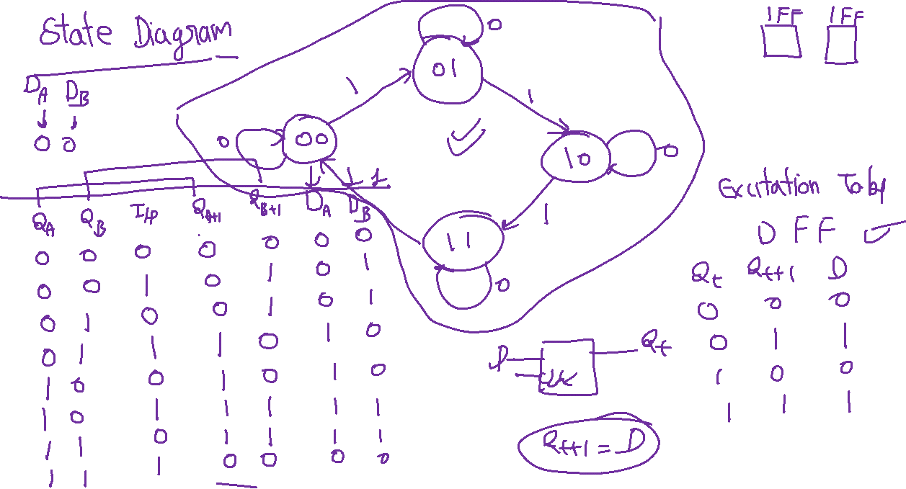

Slide 11
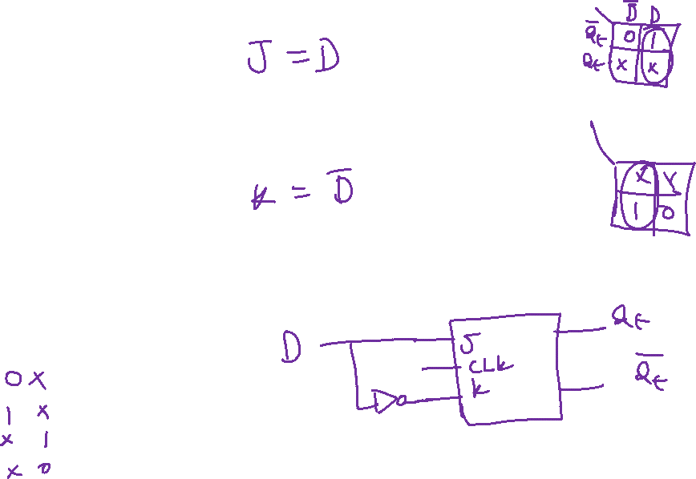
JK to D flip flop
Qt | Q(t+1) | J | K
0 | 0 | 0 | X
0 | 1 | 1 | X
1 | 0 | X | 1
1 | 1 | X | 0
Qt | D | Q(t+1) | J | K
0 | 0 | 0
0 | 1 | 1
1 | 0 | 0
1 | 1 | 1

